Slide 1

Department of Computer Science &Engineering Artificial Intelligence & Machine Learning
A.P. Shah Institute of Technology G.B.Road,Kasarvadavli, Thane(W), Mumbai-400615
UNIVERSITY OF MUMBAI
Academic Year 2023-2024

Slide 2
Virtual ClassRoom
Computer Science & Engineering Artificial Intelligence and Machine Learning
By
Sahil Govardhane (22106097)
Shreyas Joshi(22106006)
Tejas Kalokhe(22106049)
Sanket Kudale(22106059)
Under the Guidance of
Prof. Viki Patil

Slide 3
Index
Introduction
Objectives
Features
Literature survey
Block Diagram
Tools/Softwares, Languages used
Implementation
Conclusion
References

Slide 4
Introduction
The Evolution of Education.
Breaking Down Geographical Barriers.
Real-Time Interaction.
Interactive Learning Tools.
Better half of online learning.

Slide 5
Objective
Enhanced Accessibility.
Real-Time Engagement.
Flexible Learning.
Improved Learning Outcomes.
Efficient Teaching and Management.

Slide 6

"TechJourney Navigator: An AI Powered Smart Trip Planner "
Current Existing Solutions :
GoIbbibo
Airbnb
MakeMyTrip
Difference Between Existing Solution and Our Solution :
Through GoIbbibo , Airbnb and MakeMyTrip we can make booking for particular hotels, flights available on those site etc.
Through TechJourney Navigator, we can plan our journey based on our budget and find the best traveling and hotel options for that particular price point and country .

Slide 7
PROBLEM STATEMENT
One of the foremost challenges in virtual classrooms is the digital divide. While technology has made online learning possible, not all students have equal access to the necessary devices and reliable internet connections. This digital inequity exacerbates educational disparities, hindering the educational progress of underserved communities and widening existing achievement gaps. Bridging the digital divide is a fundamental issue that must be resolved to ensure that all students have equal access to virtual classrooms. Virtual classrooms often struggle to replicate the engagement and interaction levels found in traditional face-to-face settings. The absence of physical presence and non-verbal cues can lead to a sense of isolation among students. Educators must grapple with finding innovative ways to foster active participation, collaborative learning, and meaningful connections in the virtual space. Maintaining student engagement while harnessing the benefits of technology remains a critical challenge. Educators must undergo a pedagogical shift when transitioning to virtual classrooms. Traditional teaching methods may not translate effectively into the digital realm. The challenge lies in redefining teaching strategies to accommodate the unique characteristics of virtual learning environments. Educators must become proficient in utilizing digital tools, designing interactive content, and fostering a sense of community to ensure effective learning experiences.

Slide 8
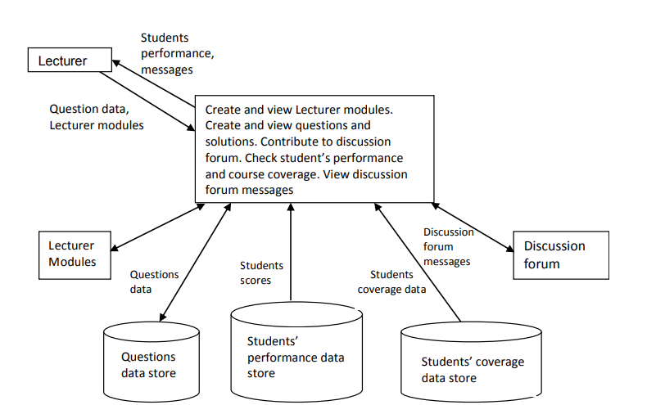
BLOCK DIAGRAM
Figure 1:Data flow diagram showing the Lecturer user module.

Slide 9
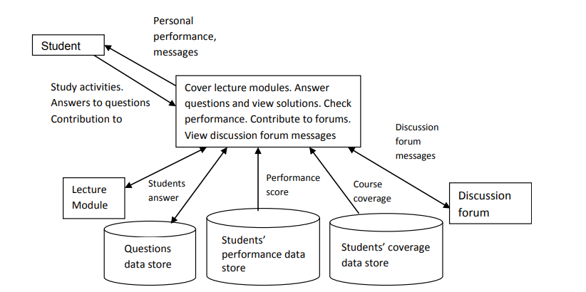
Figure 2: Data flow diagram showing the Student user module.

Slide 10






Tools/softwares, Languages used
HTML.
CSS.
BootStrap.
JAVASCRIPT.
NodeJs.
Express Js.
MYSQL(using NodeJs).
Visual Studio Code.

Slide 11
PROJECT WORK

Slide 12
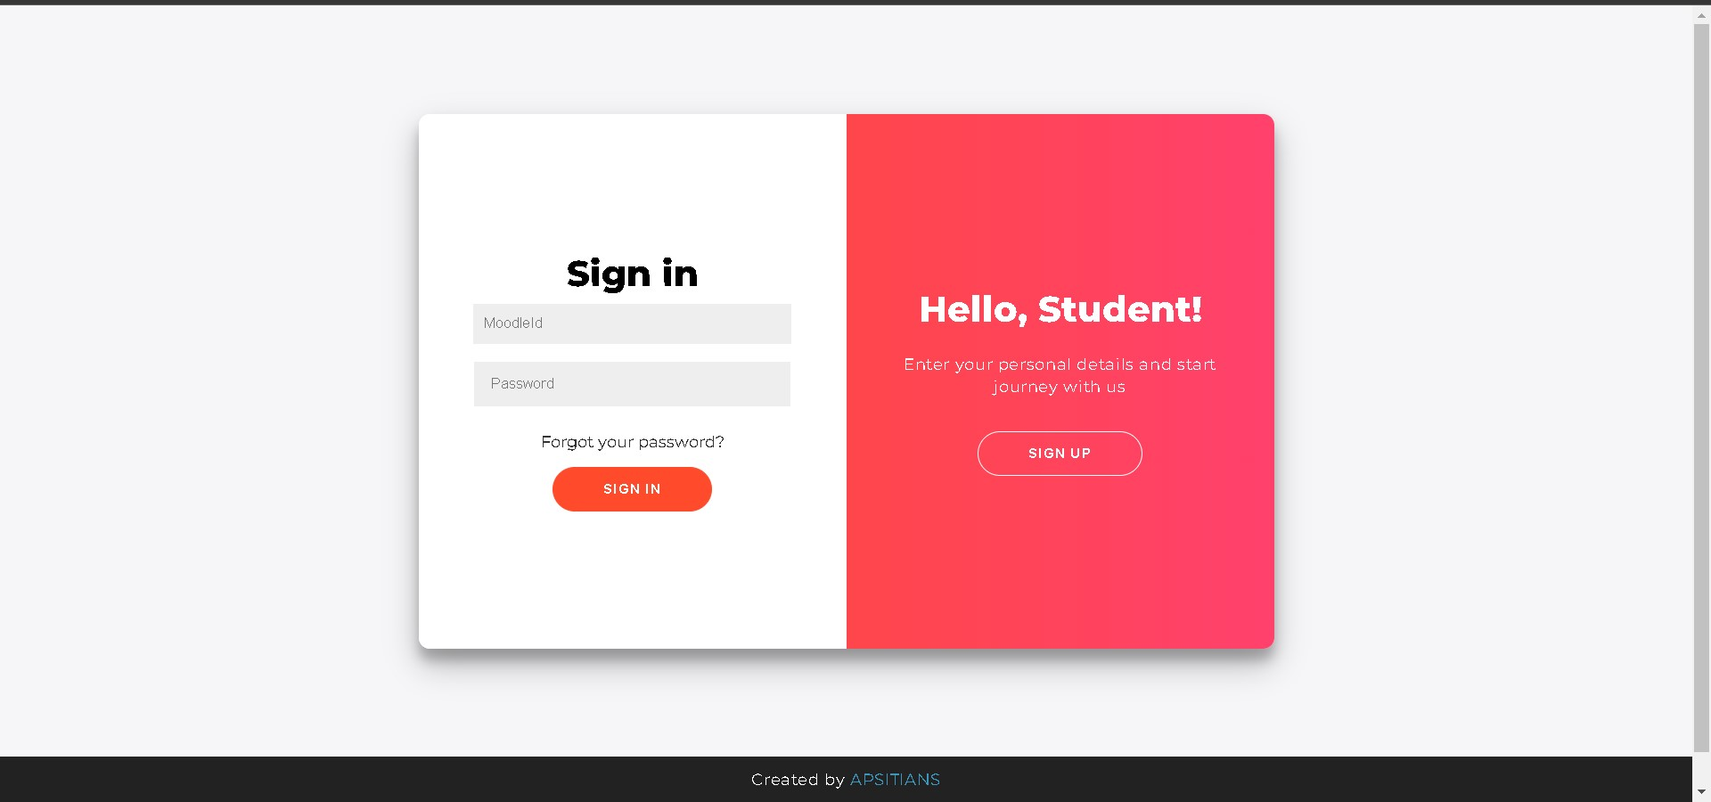
SIGN-UP / LOGIN PAGE

Slide 13
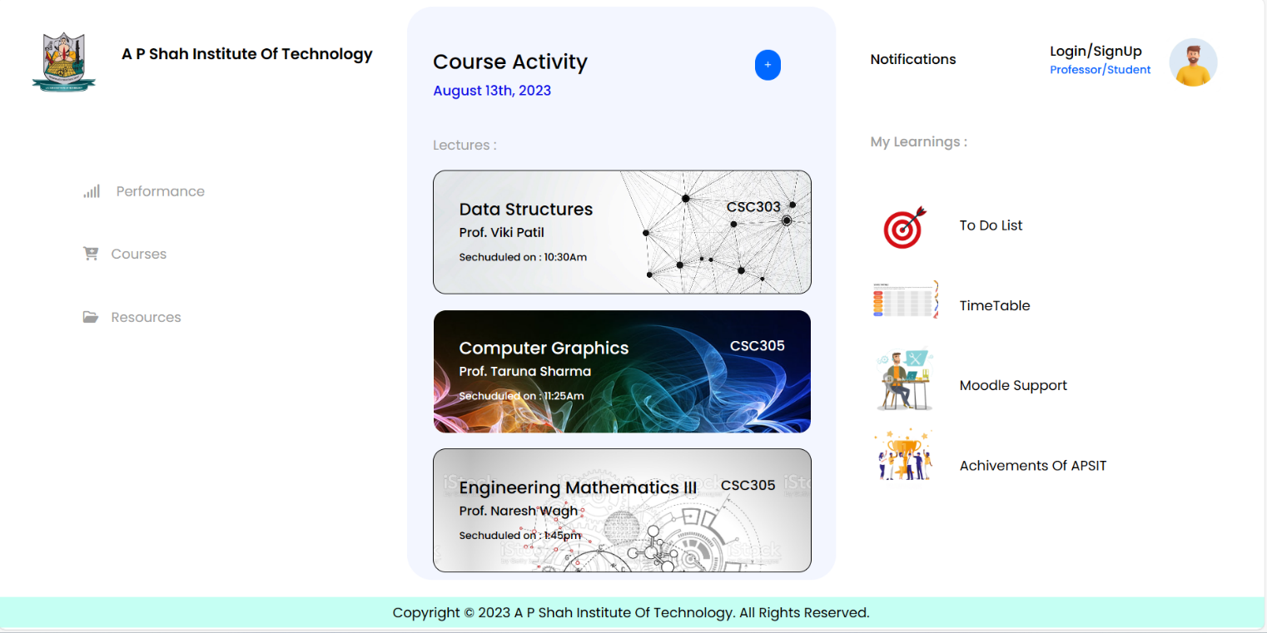
HOME PAGE USER INTERFACE

Slide 14
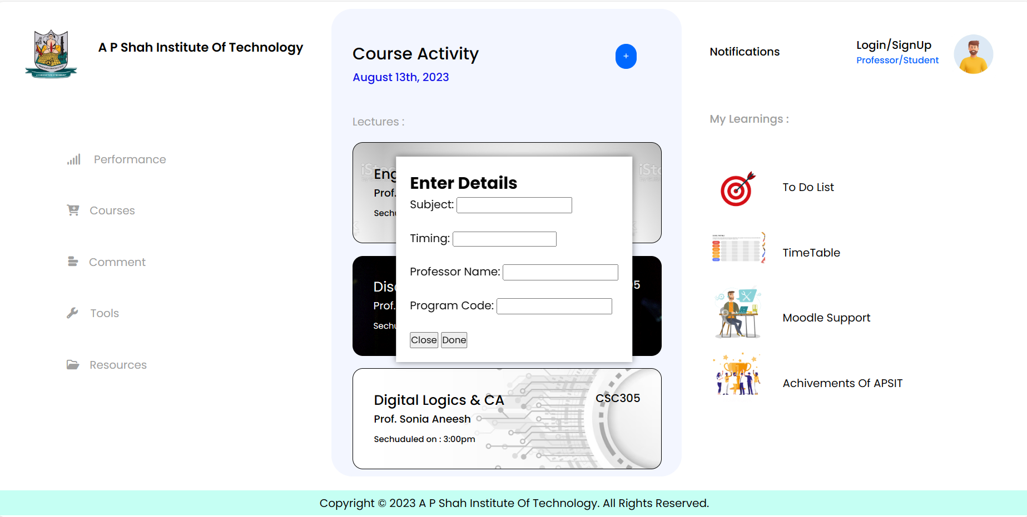
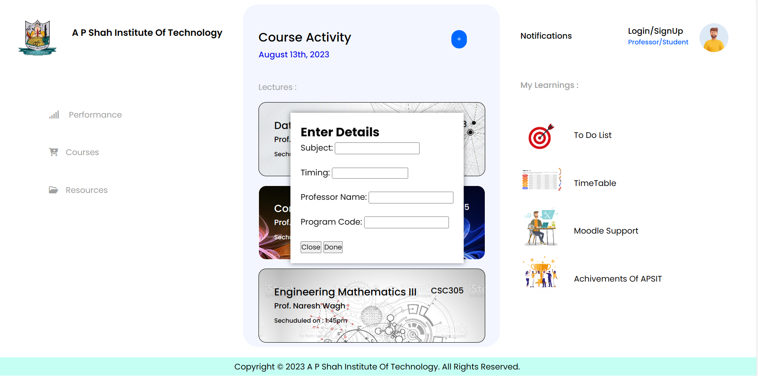
CREATION OF NEW SUBJECT LECTURE

Slide 15
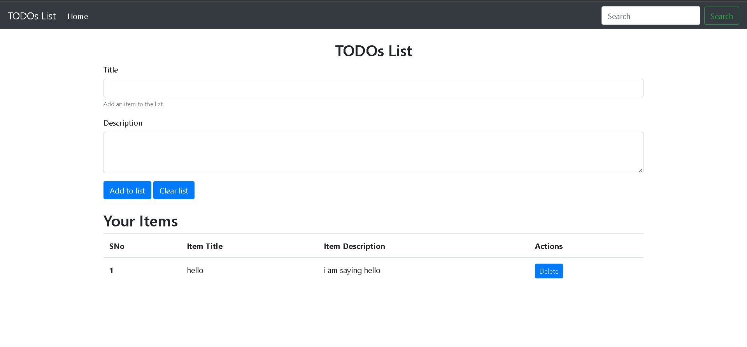

Slide 16
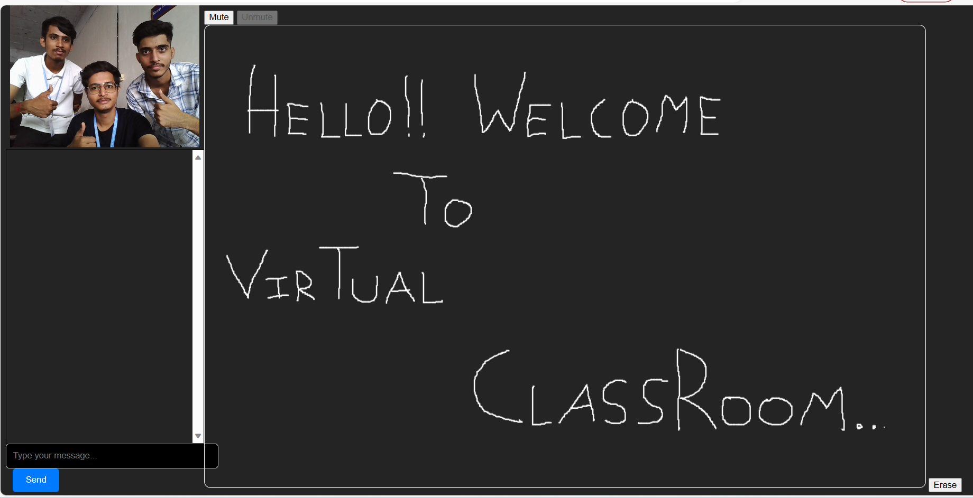
CLASSROOM INTERFACE

Slide 17
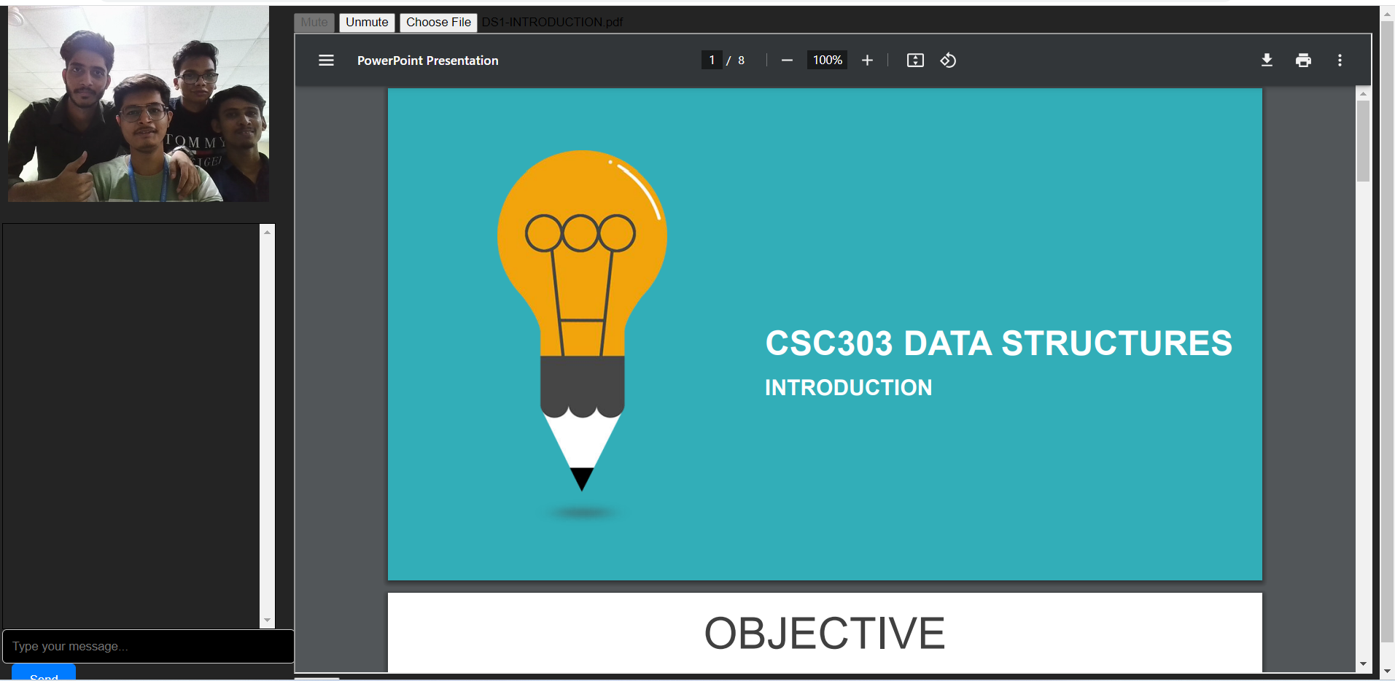
PDF SHARE FUNCTION

Slide 18
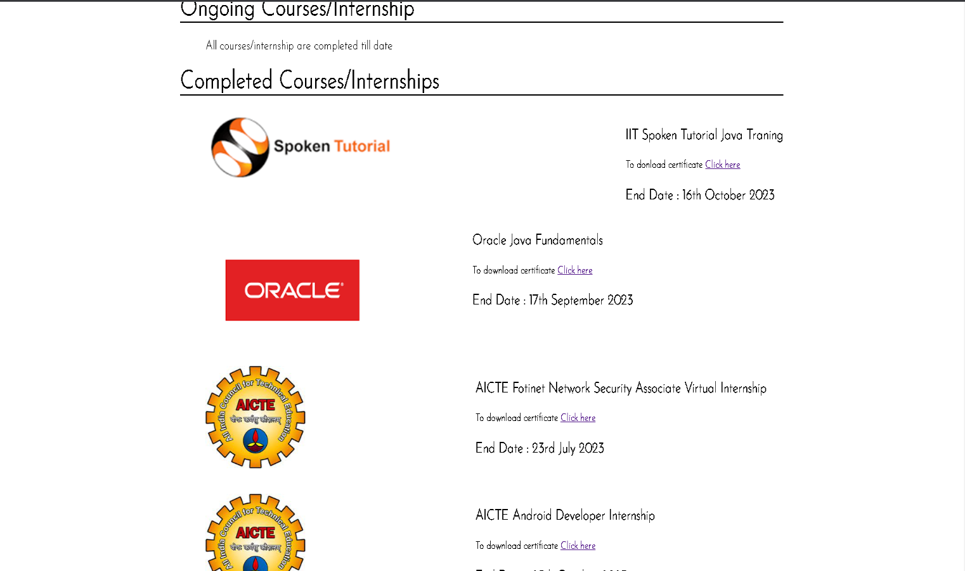
Course Section

Slide 19
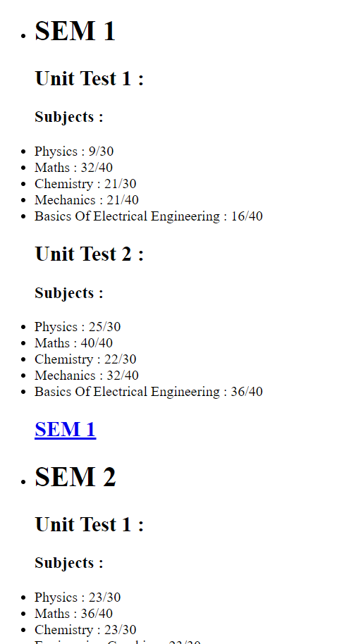
PERFORMANCE OF STUDENT

Slide 20
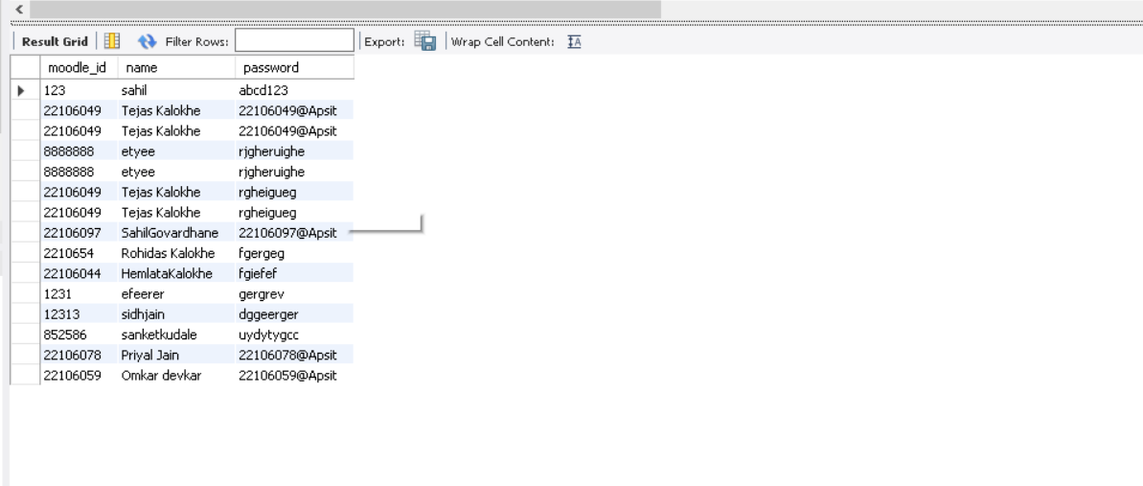
DATABASE

Slide 21
FUTURE SCOPE
1.Global Accessibility: Virtual classrooms will continue to bridge geographical barriers, allowing students from around the world to access high-quality education without the need to relocate. This will democratize education and provide opportunities to learners in remote or underserved areas.
2.Interactive Engagement: Future virtual classrooms will foster more interactive engagement among students and instructors. Features like virtual breakout rooms, real-time collaboration tools, and gamification will make learning more engaging and participatory.
3. Inclusive Education: Virtual classrooms will continue to enhance accessibility for students with disabilities. Features such as closed captioning, screen readers, and adaptive technologies will ensure that education is more inclusive than ever before.
4.Data-Driven Insights: Virtual classrooms will generate vast amounts of data about student performance and engagement. Educational institutions will leverage this data to make informed decisions, identify at-risk students, and continuously improve teaching methods.
5.Hybrid Learning: Hybrid models that combine virtual and in-person learning will become more prevalent. This flexibility will accommodate different learning preferences and adapt to unforeseen circumstances like pandemics or natural disasters.

Slide 22
Conclusion
Virtual classroom web apps empower individuals to embark on a journey of lifelong learning. By providing flexible, accessible, and engaging educational opportunities, these platforms ensure that learning doesn't stop after formal schooling, but continues throughout one's life. In a world where disruptions to traditional education can occur unexpectedly, virtual classroom web apps offer a resilient solution. We have successfully developed a web application that fulfills its intended purpose of hosting live lectures and facilitating the sharing of PDF documents. This achievement marks a significant milestone in your project's development. Our web app contributes to the enhancement of the learning experience by providing a platform for live lectures. This can be especially valuable for remote or online learning, allowing students and instructors to interact in real-time. The capability to share PDFs during lectures enhances collaboration and resource sharing among participants. This feature supports a dynamic and interactive learning environment. Depending on your project's architecture and infrastructure, it's important to consider how easily the system can scale to accommodate more users and larger file uploads. Scalability is crucial to meet increasing demand. The user interface should be intuitive and easy to navigate to encourage user adoption. Invest in user experience design to ensure that users find it pleasant to use the platform.

Slide 23
References
[1] “Development of E-learning: A Historical Review with Global Perspective Saira Niaz” by Shumaila Memon, Samina Khokhar (May 2021)
[2] “Face to face education to virtual classroom in the health sector during covid pandemic” by Monisha Mohan,Kalaiselvi Rajendiran, Veeraraghavan Gunasekaran, Ananda Vayaravel Cassinadan(2021)
[3] “A conceptual model using a digital virtual classroom learning environment” by Naphong Wannapiroon, Paitoon Pimdee(16 January 2022)
[4] “Digital tools to enrich our virtual classroom for innovative teachers & students” by Dr Bilal Ahmad Bhat (2020)

Slide 24



